Slide 1


DEPARTMENT OF PHYSICS AND NANOTECHNOLOGY
SRM INSTITUTE OF SCIENCE AND TECHNOLOGY
18PYB103J –Semiconductor Physics
Module-V Lecture-8
Fabrication Techniques-CVD and PVD
18PYB103J Module-V Lecture-8

Slide 2
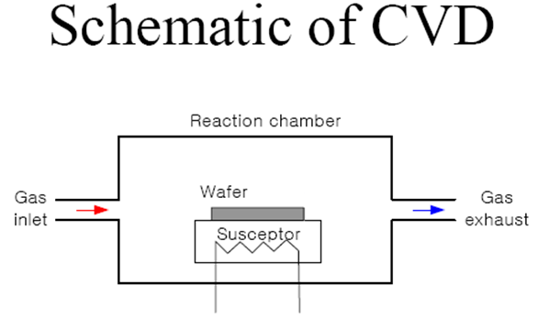
Chemical vapour Deposition
18PYB103J Module-V Lecture-8

Slide 3
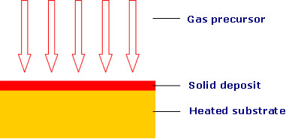
CVD REACTION
18PYB103J Module-V Lecture-8

Slide 4
A basic CVD process consists of the following steps:
A predefined mix of reactant gases and diluent inert gases are introduced at a specified flow rate into the reaction chamber;
The gas species move to the substrate;
The reactants get adsorbed on the surface of the substrate;
The reactants undergo chemical reactions with the substrate to form the film; and
The gaseous by-products of the reactions are desorbed and evacuated from the reaction chamber.
18PYB103J Module-V Lecture-8

Slide 5
During the process of chemical vapor deposition, the reactant gases not only react with the substrate material at the wafer surface (or very close to it), but also in gas phase in the reactor's atmosphere.
Reactions that take place at the substrate surface are known as heterogeneous reactions, and are selectively occurring on the heated surface of the wafer where they create good-quality films.
Reactions that take place in the gas phase are known as homogeneous reactions.
Homogeneous reactions form gas phase aggregates of the depositing material, which adhere to the surface poorly and at the same time form low-density films with lots of defects.
In short, heterogeneous reactions are much more desirable than homogeneous reactions during chemical vapor deposition.
18PYB103J Module-V Lecture-8

Slide 6
A typical CVD system consists of the following parts:
sources of and feed lines for gases;
mass flow controllers for metering the gases into the system;
a reaction chamber or reactor;
a system for heating up the wafer on which the film is to be deposited; and
temperature sensors.
18PYB103J Module-V Lecture-8

Slide 7
Types of chemical vapor deposition
A number of forms of CVD are in wide use.
These processes differ in the means by which chemical reactions are initiated (e.g., activation process) and process conditions.
For instance, a reactor is said to be 'hot-wall' if it uses a heating system that heats up not only the wafer, but the walls of the reactor itself, an example of which is radiant heating from resistance-heated coils.
'Cold-wall' reactors use heating systems that minimize the heating up of the reactor walls while the wafer is being heated up, an example of which is heating via IR lamps inside the reactor.
In hot-wall reactors, films are deposited on the walls in much the same way as they are deposited on wafers.
so this type of reactor requires frequent wall cleaning.
18PYB103J Module-V Lecture-8

Slide 8
Another way of classifying CVD reactors is by basing it on the range of their operating pressure.
Atmospheric pressure CVD (APCVD) reactors operate at atmospheric pressure, and are therefore the simplest in design.
Low-pressure CVD (LPCVD) reactors operate at medium vacuum (30-250 Pa) and higher temperature than APCVD reactors.
Plasma Enhanced CVD (PECVD) reactors also operate under low pressure, but do not depend completely on thermal energy to accelerate the reaction processes.
They also transfer energy to the reactant gases by using an RF-induced glow discharge.
18PYB103J Module-V Lecture-8

Slide 9
The glow discharge used by a PECVD reactor is created by applying an RF field to a low-pressure gas, creating free electrons within the discharge region.
The electrons are sufficiently energized by the electric field that gas-phase dissociation and ionization of the reactant gases occur when the free electrons collide with them.
Energetic species are then adsorbed on the film surface, where they are subjected to ion and electron bombardment, rearrangements, reactions with other species, new bond formation, and film formation and growth.
Table compares the characteristics of typical APCVD, LPCVD, and PECVD reactors.
18PYB103J Module-V Lecture-8

Slide 10
APCVD, LPCVD, and PECVD Comparison
CVD Process | Advantages | Disadvantages | Applications
APCVD | Simple, Fast Deposition, Low Temperature | Poor Step Coverage, Contamination | Low-temperature Oxides
LPCVD | Excellent Purity, Excellent Uniformity, Good Step Coverage, Large Wafer Capacity | High Temperature, Slow Deposition | High-temperature Oxides, Silicon Nitride, Poly-Si, W, WSi₂
PECVD | Low Temperature, Good Step Coverage | Chemical and Particle Contamination | Low-temperature Insulators over Metals, Nitride Passivation
18PYB103J Module-V Lecture-8

Slide 11
Advantages of CVD
Can be used for a wide range of metals and ceramics
Can be used for coatings or freestanding structures
Fabricates net or near-net complex shapes
Is self-cleaning—extremely high purity deposits (>99.995% purity)
Conforms homogeneously to contours of substrate surface
Has near-theoretical as-deposited density
Has controllable thickness and morphology
Forms alloys
Infiltrates fiber preforms and foam structures
Coats internal passages with high length-to-diameter ratios
Can simultaneously coat multiple components
Coats powders
18PYB103J Module-V Lecture-8

Slide 12
Applications
CVD processes are used on a surprisingly wide range of industrial components, from aircraft and land gas turbine blades, timing chain pins for the automotive industry, radiant grills for gas cookers and items of chemical plant, to resist various attacks by carbon, oxygen and sulphur.
Some important applications are listed below.
Surface modification to prevent or promote adhesion
Photoresist adhesion for semiconductor wafers Silane/substrate adhesion for microarrays (DNA, gene, protein, antibody, tissue)
MEMS coating to reduce stiction
BioMEMS and biosensor coating to reduce "drift" in device performance
Promote biocompatibility between natural and synthetic materials Copper capping Anti-corrosive coating
18PYB103J Module-V Lecture-8

Slide 13
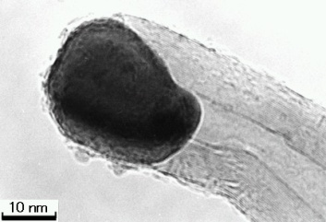
CVD
Advantages
Easy to increase scale to industrial production
Large length
Simple to perform
Pure product
Disadvantages
http://endomoribu.shinshu-u.ac.jp/research/cnt/images/cat_cnt.jpg
Defects are common
18PYB103J Module-V Lecture-8
Notes:
30 s

Slide 14
Physical Vapour Deposition(PVD) Introduction 1.Physical vapour deposition (PVD) is fundamentally a vaporisation coating technique, involving transfer of material on an atomic level. It is an alternative process to electroplating 2.The process is similar to chemical vapour deposition (CVD) except that the raw materials/precursors, i.e. the material that is going to be deposited starts out in solid form, whereas in CVD, the precursors are introduced to the reaction chamber in the gaseous state.
Working Concept PVD processes are carried out under vacuum conditions. The process involved four steps: 1.Evaporation 2.Transportation 3.Reaction 4.Deposition
18PYB103J Module-V Lecture-8

Slide 15
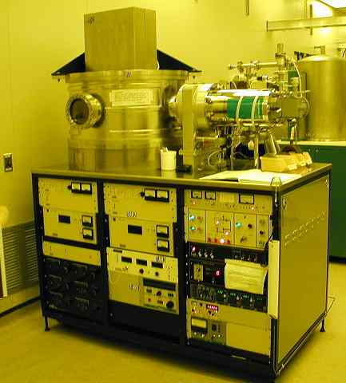
18PYB103J Module-V Lecture-8

Slide 16
Evaporation During this stage, a target, consisting of the material to be deposited is bombarded by a high energy source such as a beam of electrons or ions. This dislodges atoms from the surface of the target, ‘vaporising’ them.
Transport This process simply consists of the movement of ‘vaporised’ atoms from the target to the substrate to be coated and will generally be a straight line affair.
Reaction
In some cases coatings will consist of metal oxides, nitrides, carbides and other such materials.
In these cases, the target will consist of the metal.
The atoms of metal will then react with the appropriate gas during the transport stage.
For the above examples, the reactive gases may be oxygen, nitrogen and methane. In instances where the coating consists of the target material alone, this step would not be part of the process.
18PYB103J Module-V Lecture-8

Slide 17
Deposition This is the process of coating build up on the substrate surface. Depending on the actual process, some reactions between target materials and the reactive gases may also take place at the substrate surface simultaneously with the deposition process. Fig. shows a schematic diagram of the principles behind one common PVD method. The component that is to be coated is placed in a vacuum chamber. The coating material is evaporated by intense heat from, for example, a tungsten filament. An alternative method is to evaporate the coating material by a complex ion bombardment technique. The coating is then formed by atoms of the coating material being deposited onto the surface of the component being treated.
18PYB103J Module-V Lecture-8

Slide 18
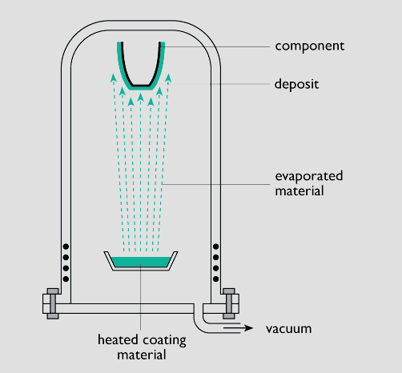
The vacuum evaporation PVD process
18PYB103J Module-V Lecture-8

Slide 19
Variants of PVD include, in order of increasing novelty: Evaporative Deposition: In which the material to be deposited is heated to a high vapor pressure by electrically resistive heating in "high" vacuum. Electron Beam Physical Vapor Deposition: In which the material to be deposited is heated to a high vapor pressure by electron bombardment in "high" vacuum. Sputter Deposition: In which a glow plasma discharge (usually localized around the "target" by a magnet) bombards the material sputtering some away as a vapor. Cathodic Arc Deposition: In which a high power arc directed at the target material blasts away some into a vapor. Pulsed Laser Deposition: In which a high power laser ablates material from the target into a vapor.
18PYB103J Module-V Lecture-8

Slide 20
Merits and Demerits of evaporation methods
Method | Merits | Demerits
E-Beam Evaporation | 1. high temp materials 2. good for liftoff 3. highest purity | 1. some CMOS processes sensitive to radiation 2. alloys difficult 3. poor step coverage
Filament Evaporation | 1. simple to implement 2. good for liftoff | 1. limited source material (no high temp) 2. alloys difficult 3. poor step coverage
Sputter Deposition | 1. better step coverage 2. alloys 3. high temp materials 4. less radiation damage | 1. possible grainy films 2. porous films 3. plasma damage/contamination
18PYB103J Module-V Lecture-8

Slide 21
Importance of PVD Coatings
PVD coatings are deposited for numerous reasons. Some of the main ones are:
Improved hardness and wear resistance
Reduced friction
Improved oxidation resistance
The use of such coatings is aimed at improving efficiency through improved performance and longer component life.
They may also allow coated components to operate in environments that the uncoated component would not otherwise have been able to perform.
18PYB103J Module-V Lecture-8

Slide 22
Advantages
Materials can be deposited with improved properties compared to the substrate material
Almost any type of inorganic material can be used as well as some kinds of organic materials
The process is more environmentally friendly than processes such as electroplating
Disadvantages
It is a line of sight technique meaning that it is extremely difficult to coat undercuts and similar surface features
High capital cost
Some processes operate at high vacuums and temperatures requiring skilled operators
Processes requiring large amounts of heat require appropriate cooling systems
The rate of coating deposition is usually quite slow
18PYB103J Module-V Lecture-8

Slide 23
Applications
PVD coatings are generally used to improve hardness, wear resistance and oxidation resistance.
Thus, such coatings use in a wide range of applications such as:
Aerospace
Automotive
Surgical/Medical
Dies and moulds for all manner of material processing
Cutting tools
18PYB103J Module-V Lecture-8

